Slide 1

Welcome to the 13th Annual Alliance for Aging Golf Tournament

Slide 2

We thank our Title Sponsor
Florida Healthcare Plus

Slide 3
The Alliance funds home and community-based services that help keep people at home and out of nursing homes.

Slide 4
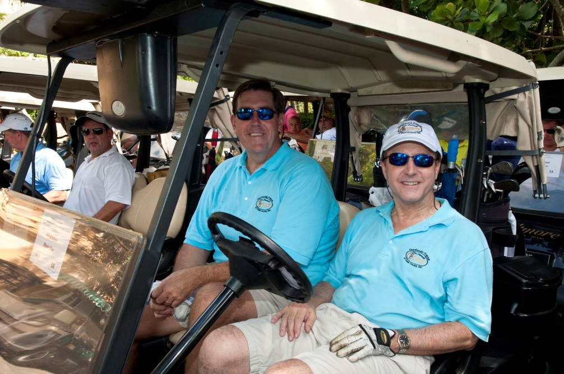
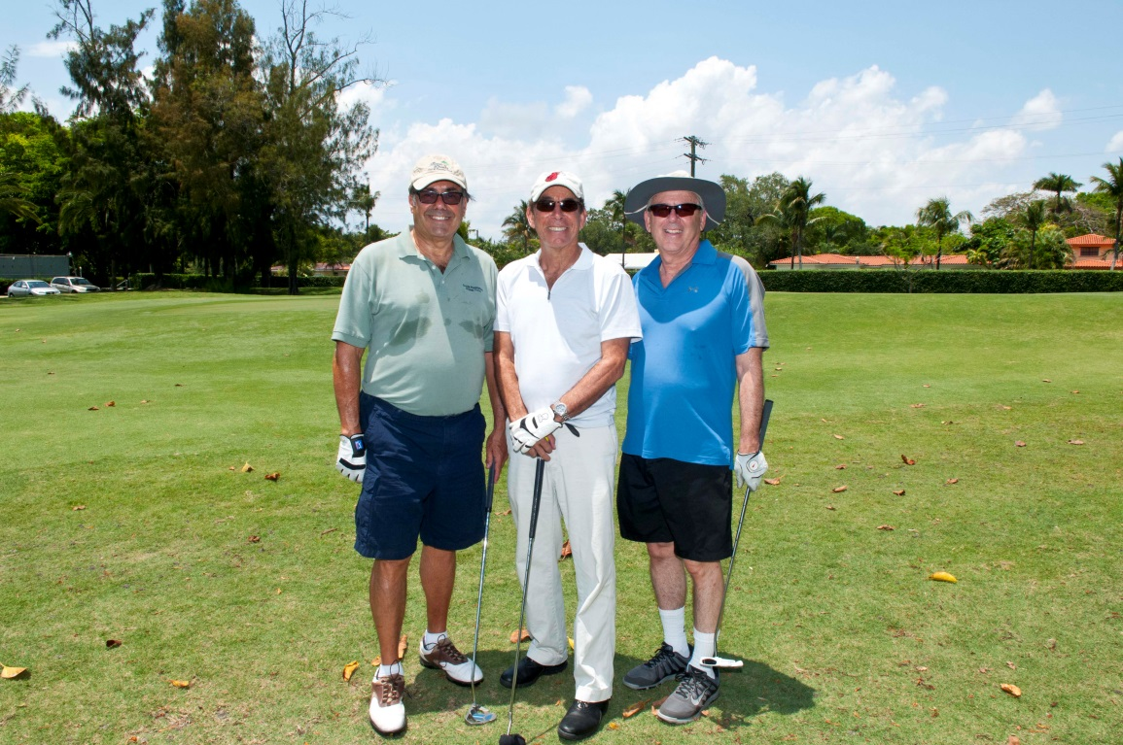

Slide 5

Enjoy your Dinner compliments of

Slide 6
Mother’s Day is Sunday, May 11th
Check out the silent auction for some great Mother’s Day gifts for your Mother, Wife or Daughter, and help the Alliance for Aging, Inc. at the same time!

Slide 7

Our Presenting Sponsor:
S.T.E.P.S. in the Right Direction

Slide 8
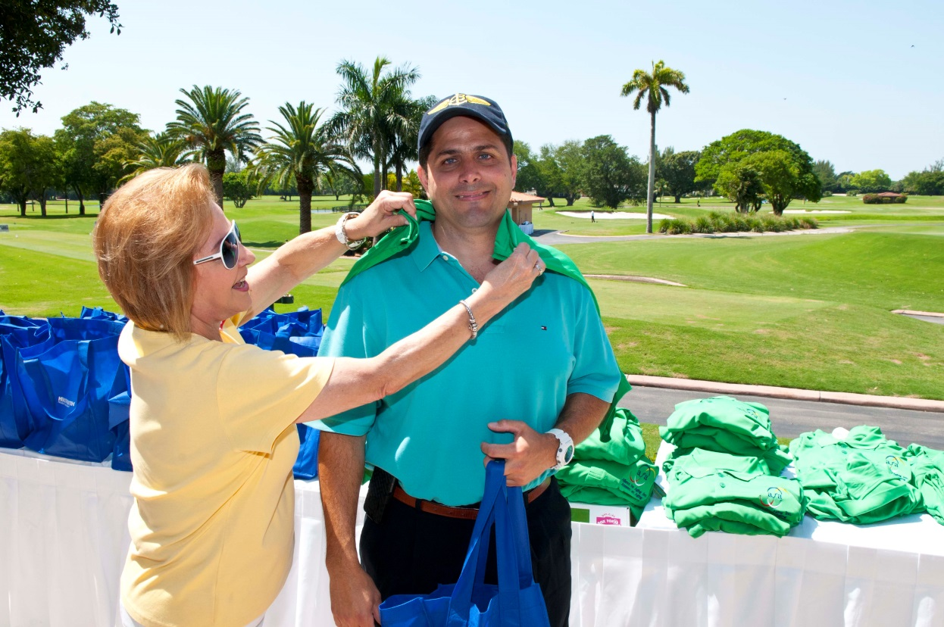
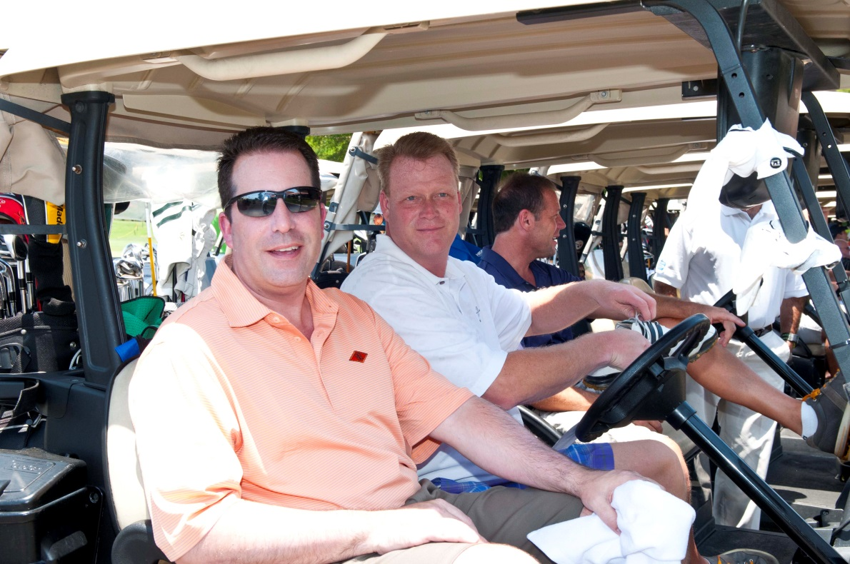

Slide 9
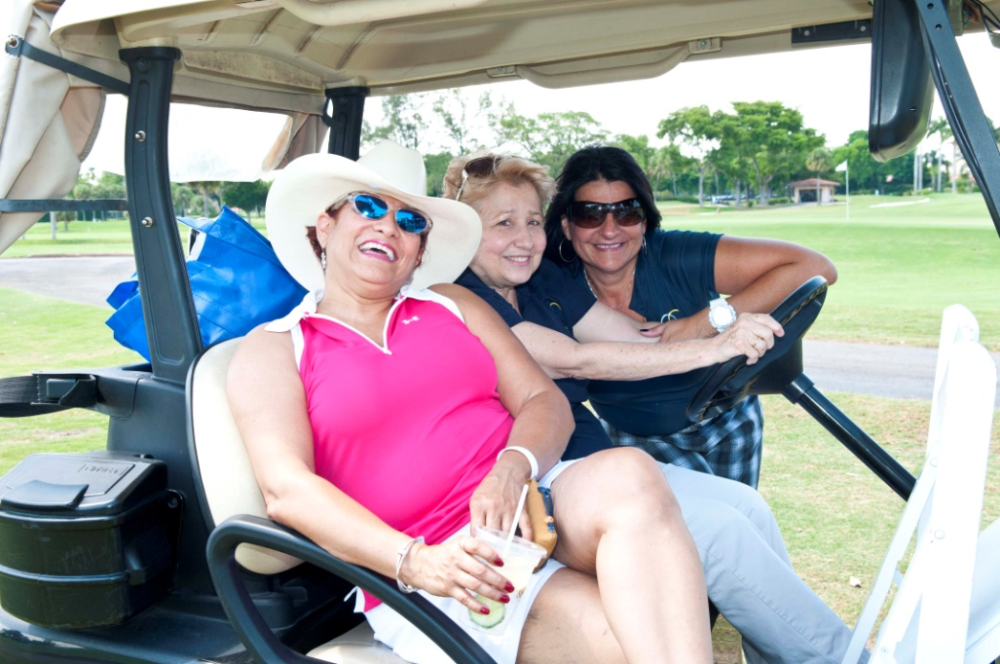
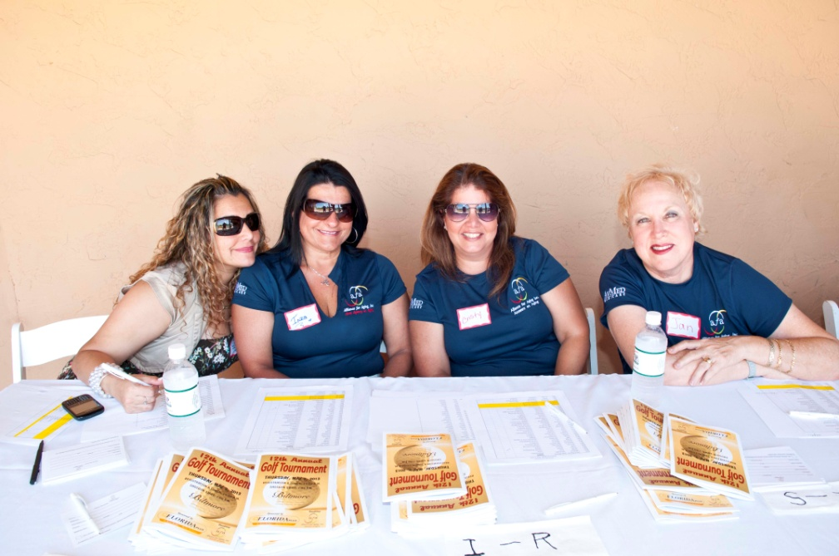
Thank you, Volunteers!

Slide 10

Many thanks to our Shirt Sponsor

Slide 11
Welcome to the 13th Annual Alliance for Aging Golf Tournament

Slide 12
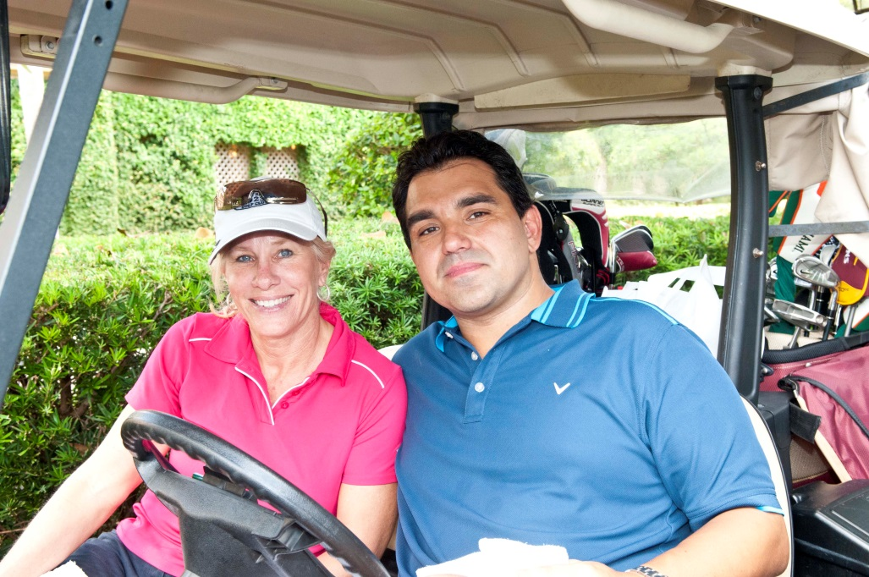
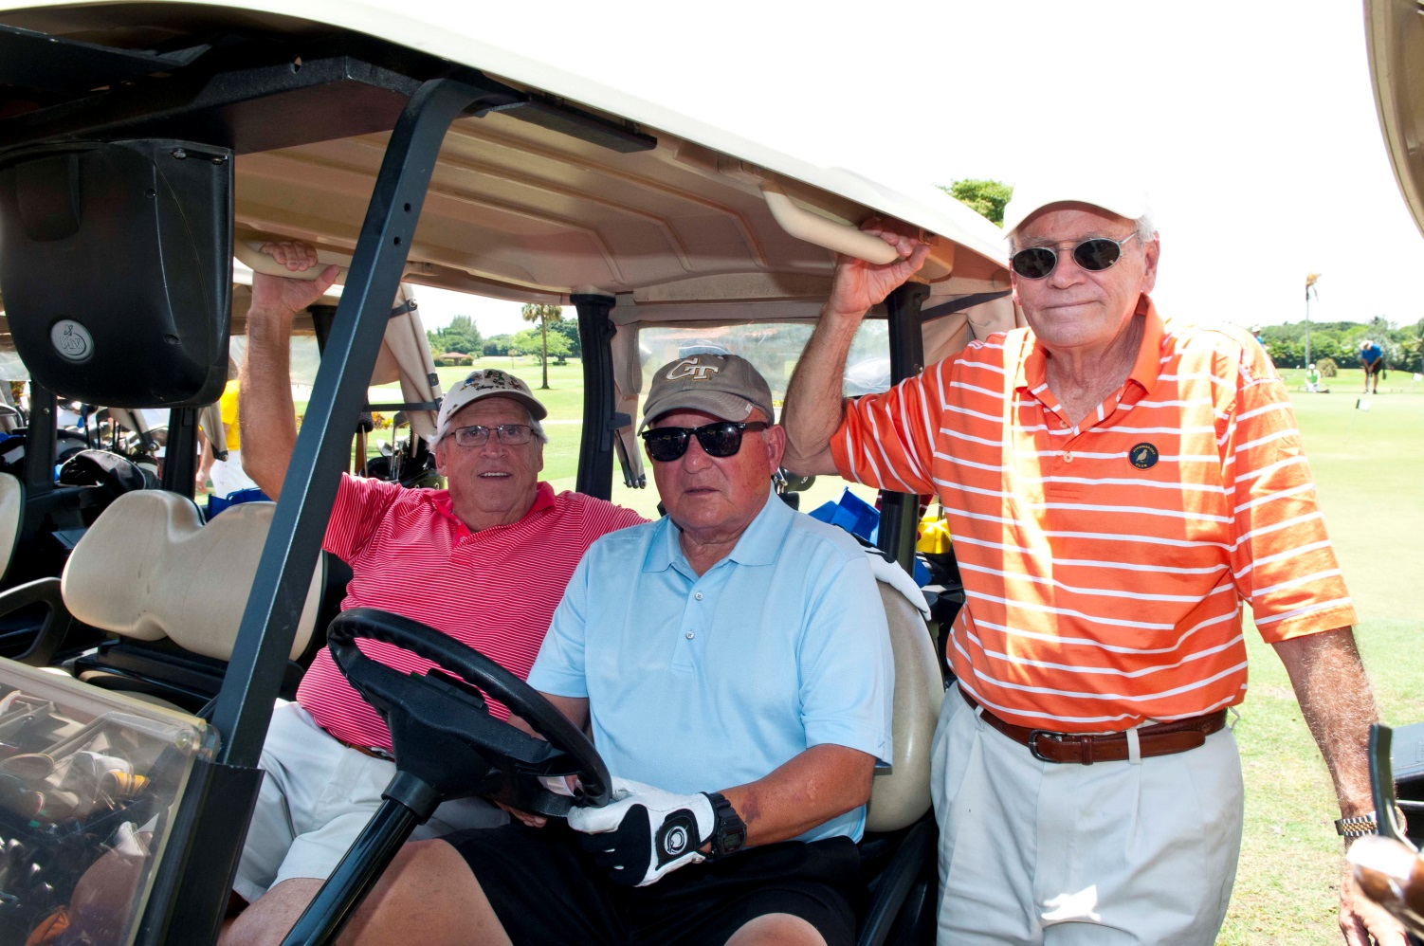


Slide 13

Some of the services we fund:
Meals served in senior centers,
and to home-bound elders
❒ In-home services including personal care and homemaking

Slide 14






BioReference Laboratories
Eastern Courier
Florida Power and Light
Health Foundation of South Florida
SGI Resorts International
Tenet Healthcare
Many thanks to our Corporate Sponsors

Slide 15
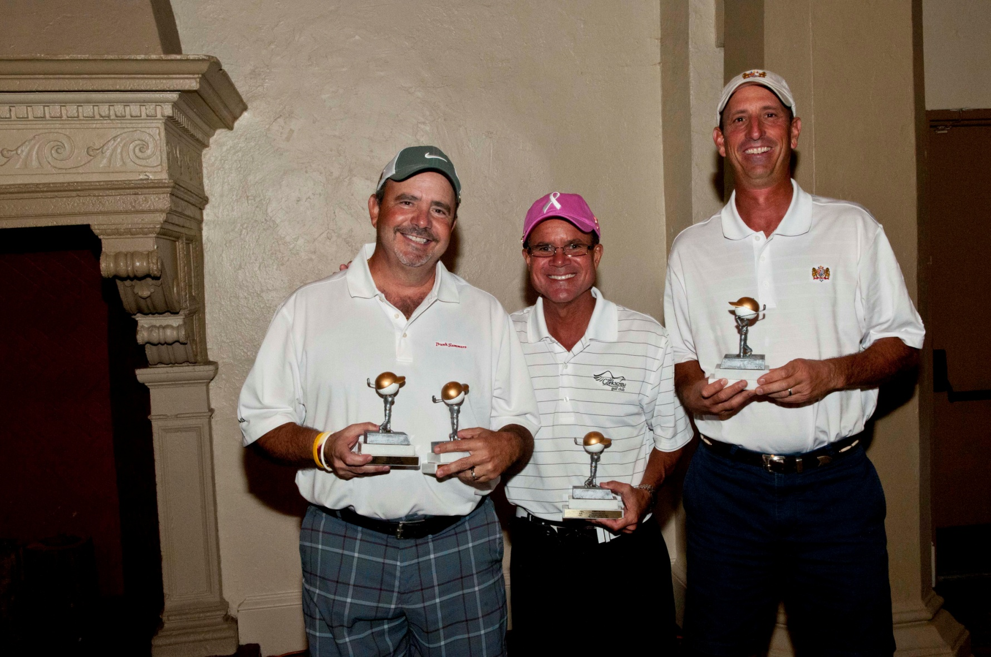
2012 Winner – Zuni Transportation

Slide 16
Some of the services we fund:
Caregiver respite and
adult day care
❒ Trips for elders needing transportation services

Slide 17
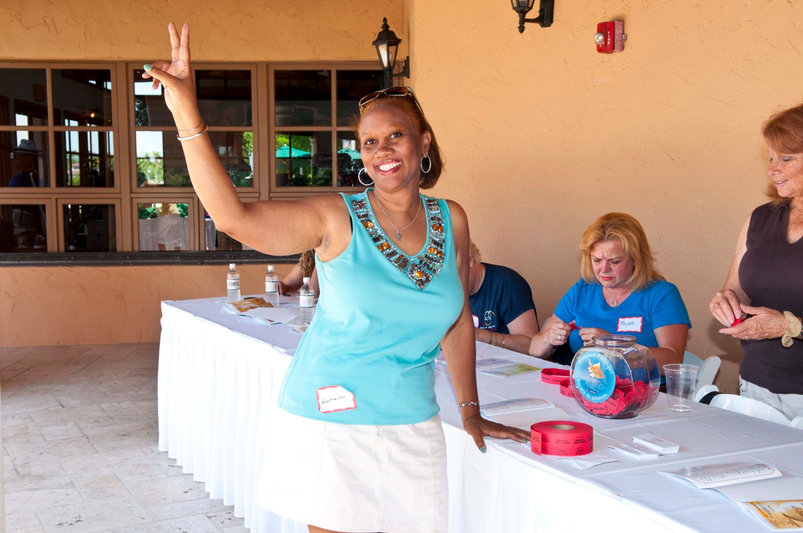
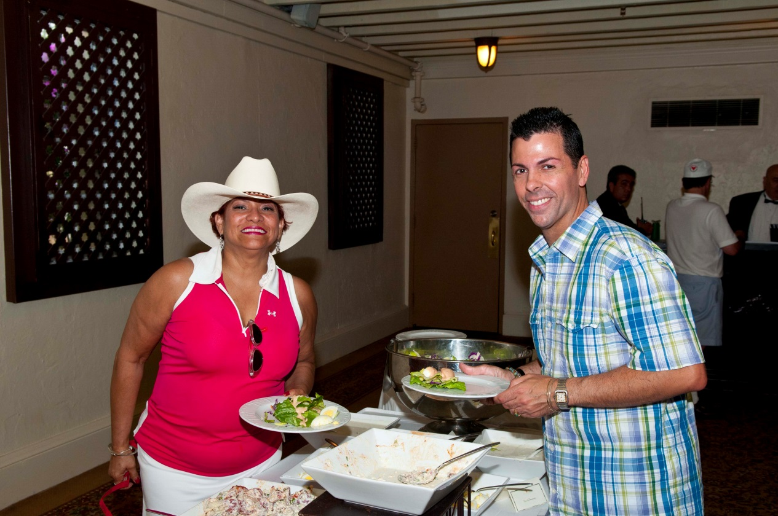

Slide 18
Raffle and Auction Donors:
Actor's Playhouse
Adrienne Arsht Center
Albert Barg Photography
AMC Movie Theaters
Aquatica
Benihana, Inc.
Big Time Restaurant Group
Books & Books
Carmine’s
City Hall The Restaurant
(continued)

Slide 19
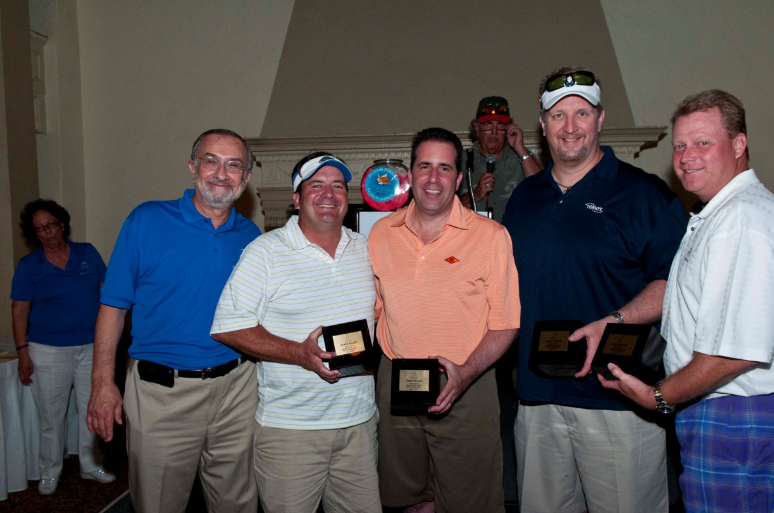
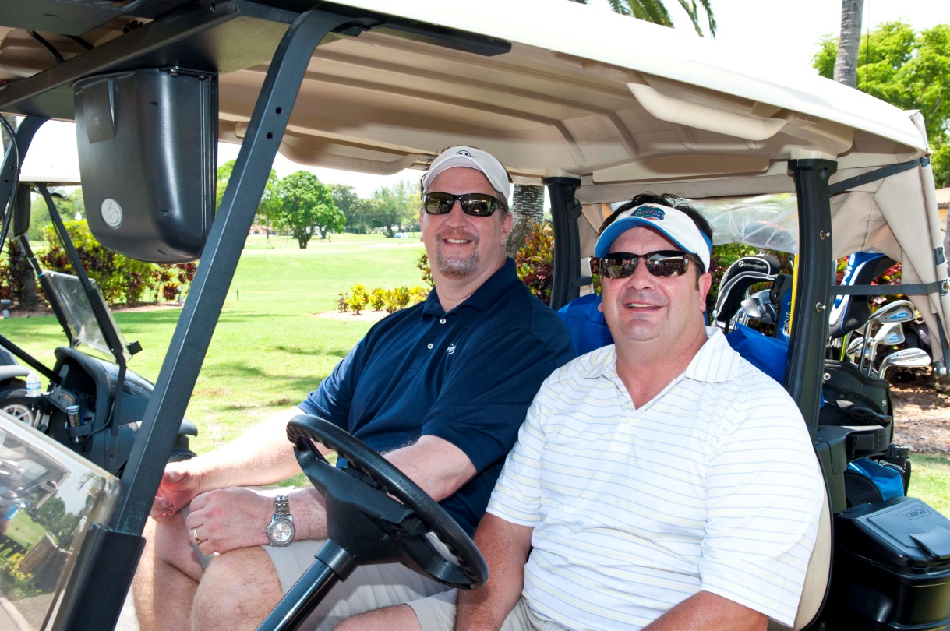

Slide 20
The Helpline, provides information and referral to community resources for older adults, adults with disabilities, their caregivers, and family members.
(305) 670-HELP (4357)
(800) 96-ELDER.
Aging and Disability Resource Center

Slide 21
Mother’s Day is Sunday, May 11th
Check out the silent auction for some great Mother’s Day gifts for your Mother, Wife or Daughter, and help the Alliance for Aging, Inc. at the same time!

Slide 22


Thanks to our hat sponsor,
Heart Med Pharmacy
Thanks to our
Towel Sponsor,
Loving Heart Home Healthcare, Inc.

Slide 23
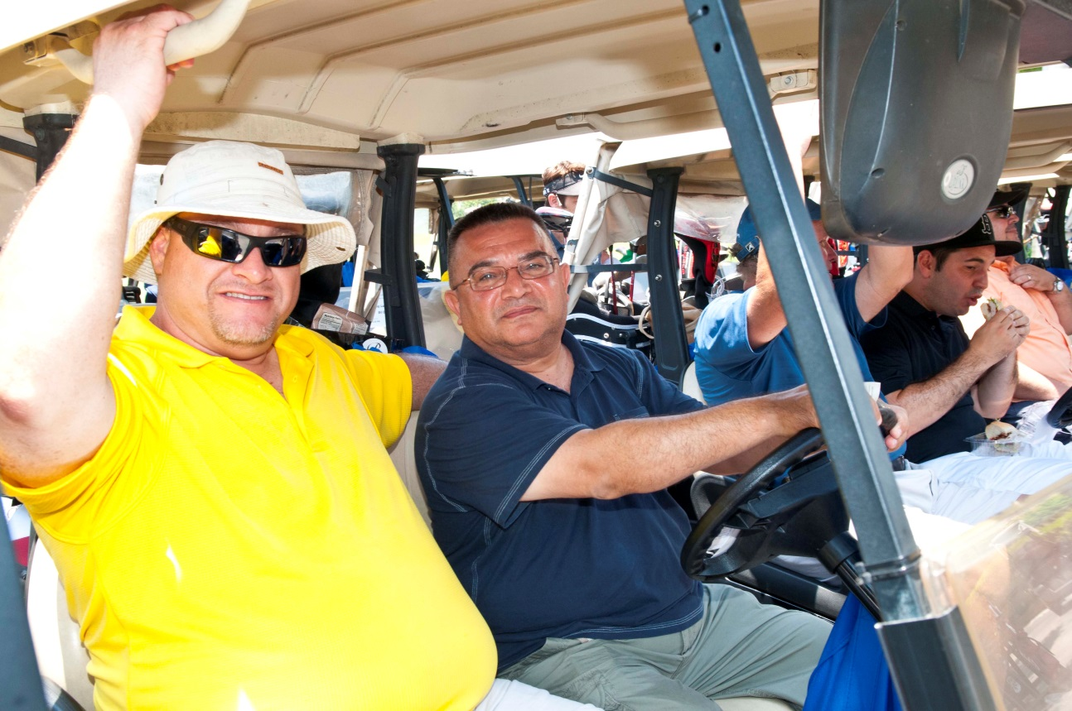
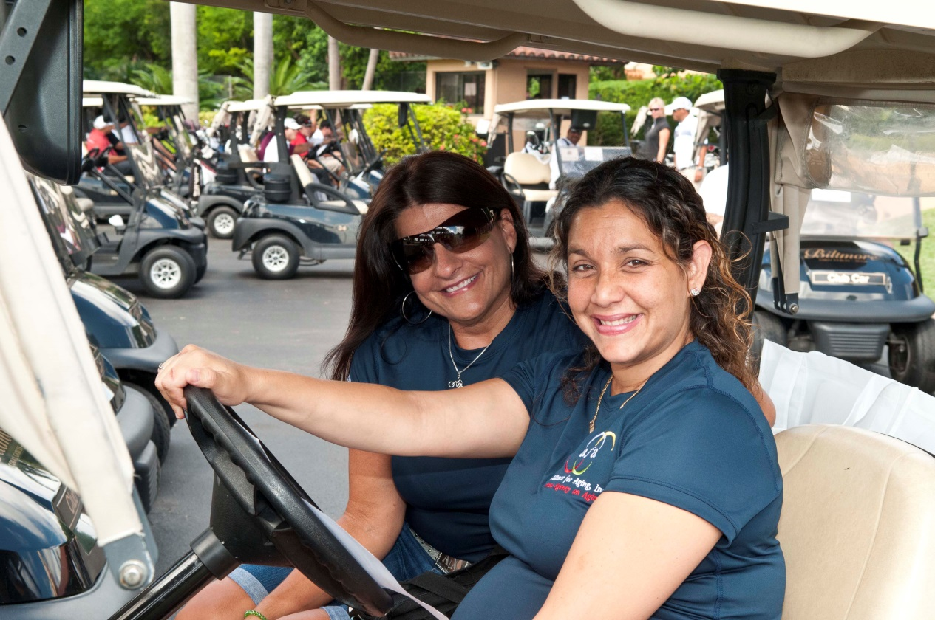

Slide 24
Raffle and Auction Donors:
Corbett's Sports Bar and Grill
DeJesus Chiropractic Center
Divieto Ristorante
Fairchild Tropical Botanic Garden
Florida Panthers
Fresco California Bistro
Fruit and Spice Park
Gable Stage Theatre
Joe's Stone Crab Restaurant
(continued)

Slide 25
Welcome to the 13th Annual Alliance for Aging Golf Tournament

Slide 26


Hole in One Sponsor

Slide 27
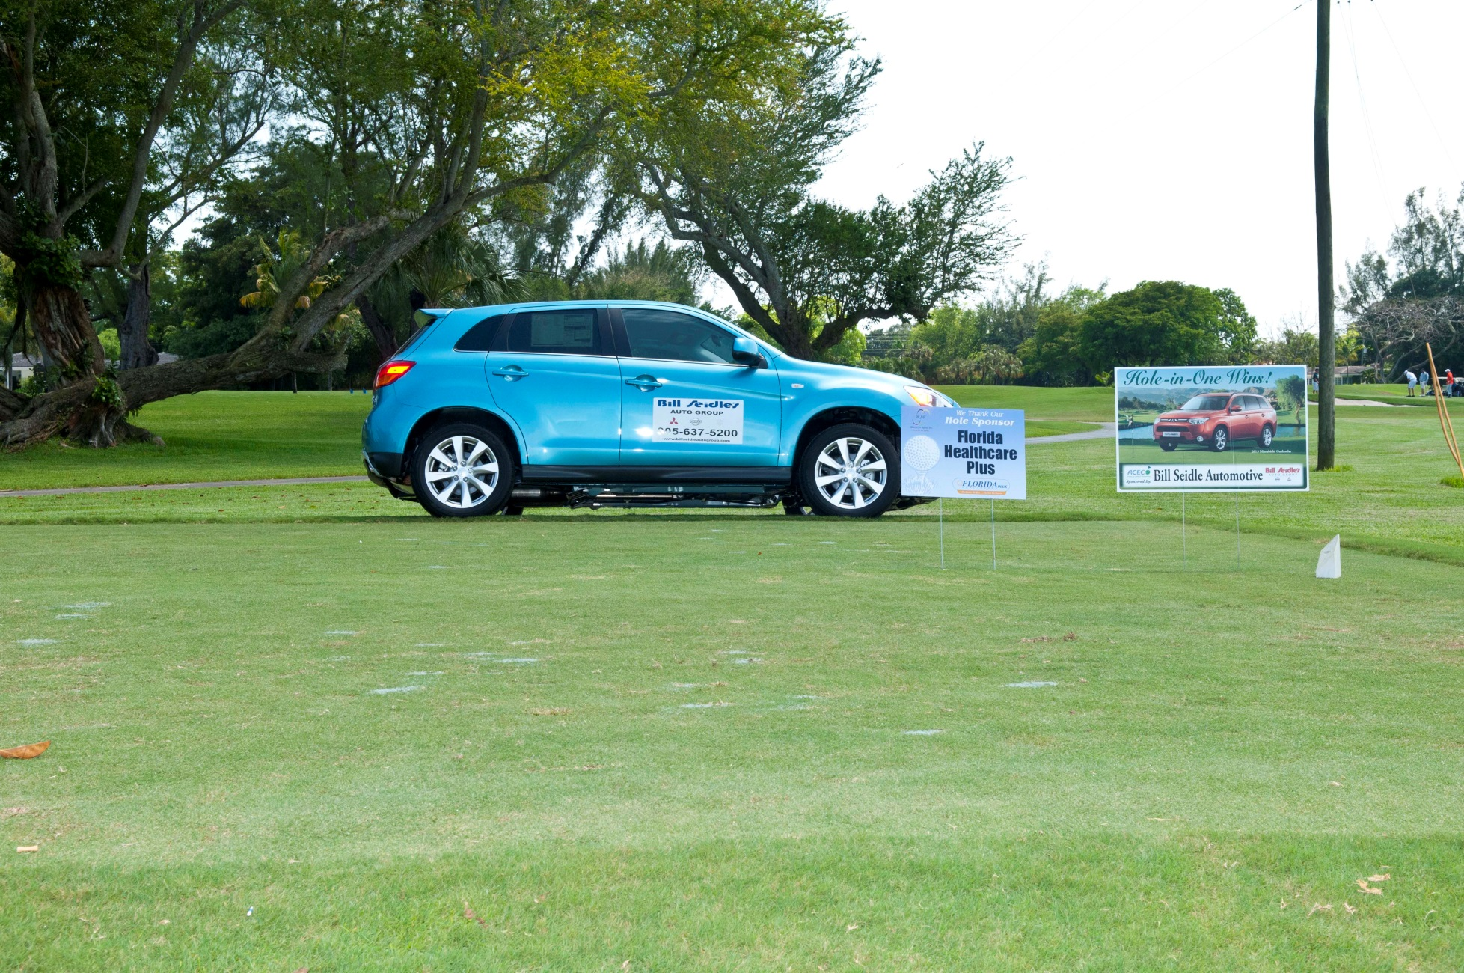

Slide 28




Diana Food Group
Faith Health Care
NurseCare, Inc.
Harvey Tabin and Associates
If you were refreshed
on the course, thank….

Slide 29

Pedestrian Safety Program
Safe Steps-Pasos Seguros offers pedestrian safety workshops for elders to address the high number of deaths and injuries among pedestrians aged 60+ in Miami-Dade and Monroe Counties.

Slide 30
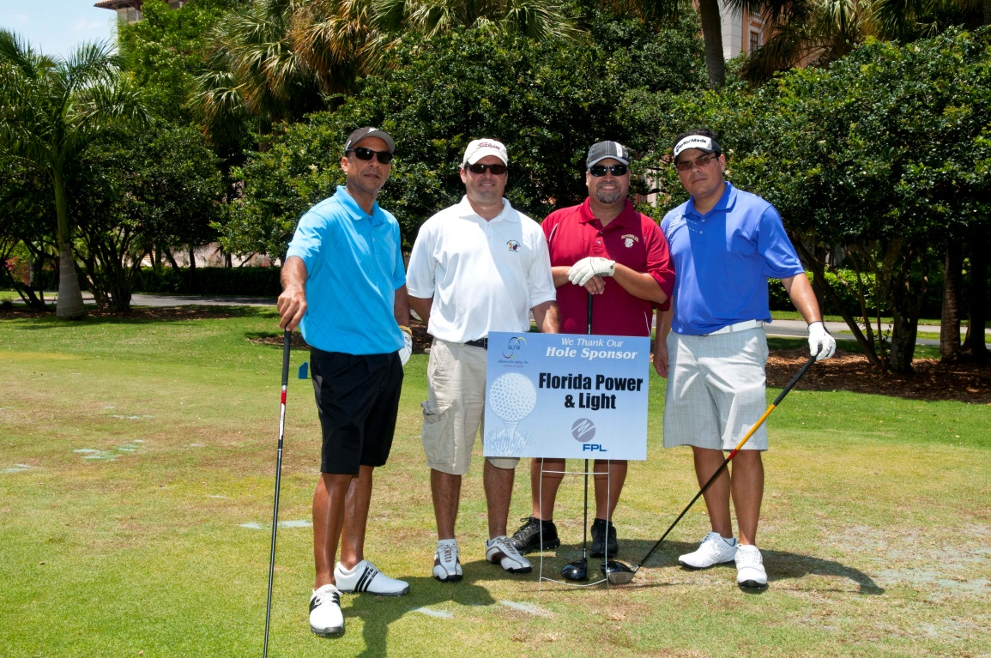

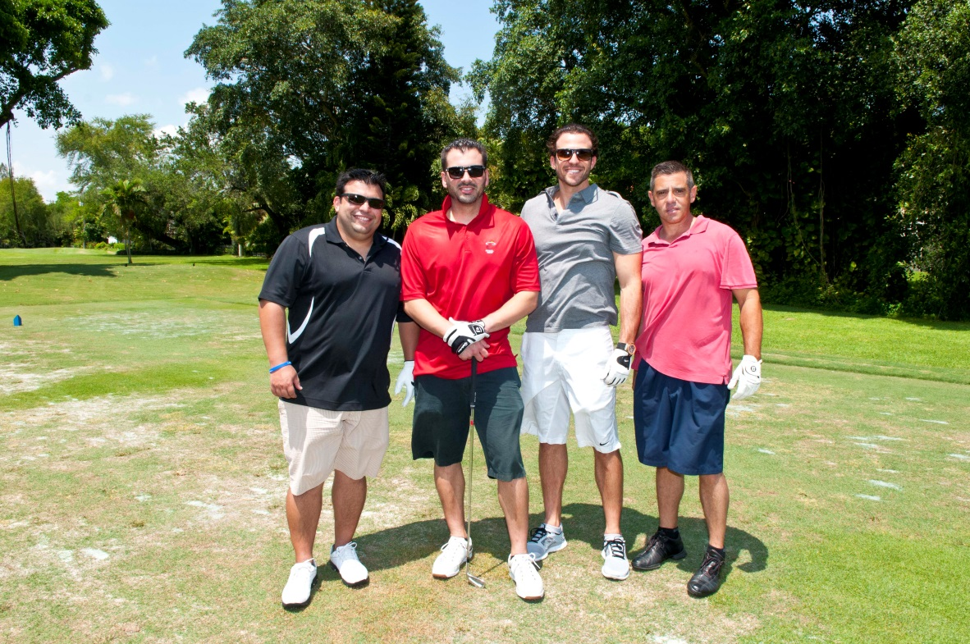

Slide 31

Smile for the Camera!
Our photo sponsor is
Tate Enterprises/The Tate Family

Slide 32
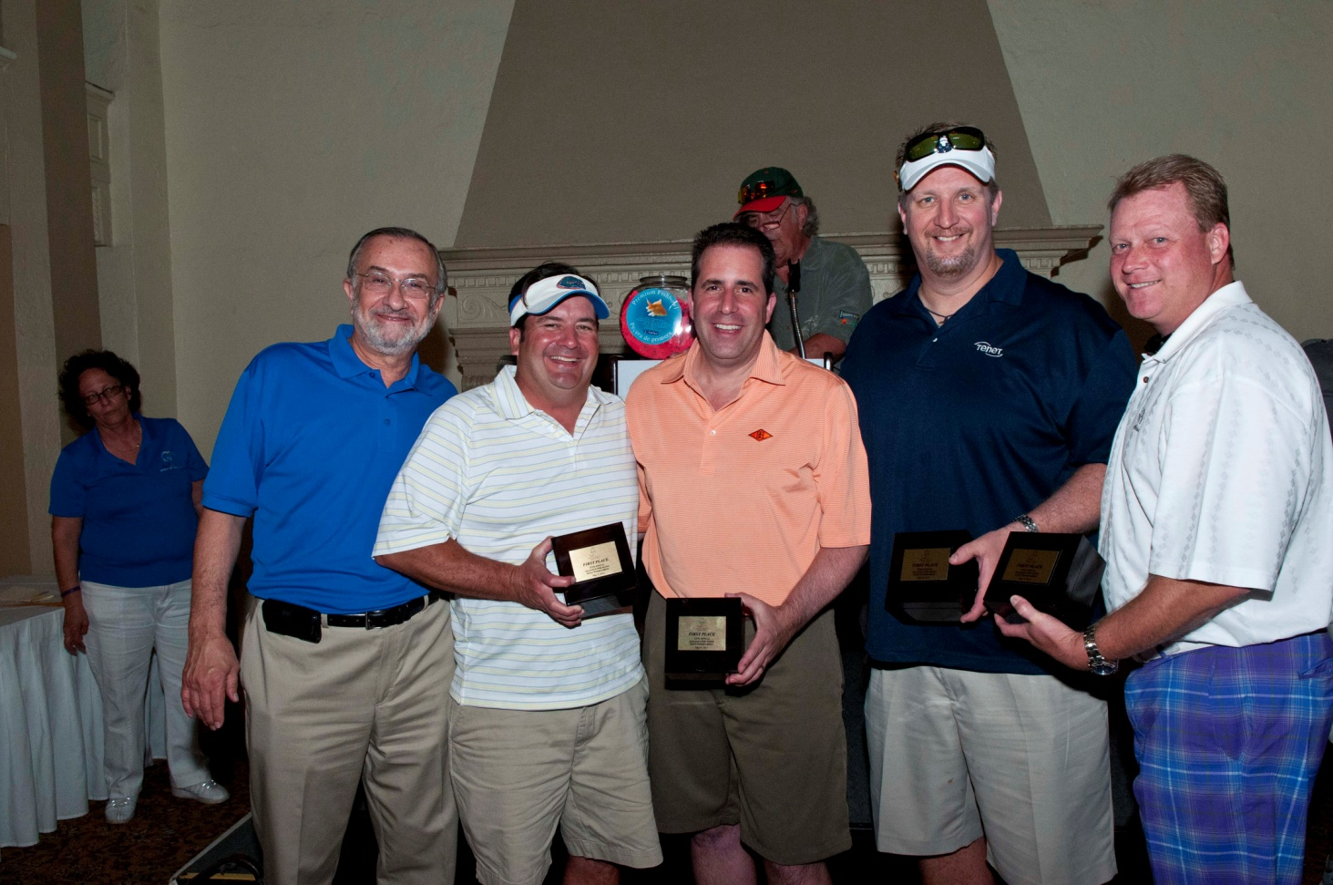
2013 Winners - Tenet Healthcare

Slide 33
Welcome to the 13th Annual Alliance for Aging Golf Tournament

Slide 34
Raffle and Auction Donors:
Jungle Island
Jungle Queen Inc.
Le Chocolatier
Maroosh Mediterranean Restaurant
Miami Dolphins, Ltd.
Miami Heat Foundation
Miami Marlins Foundation
Miami Seaquarium
Pam Martin
Publix Supermarkets
(continued)

Slide 35
Thanks to our golf ball sponsor…
Robert H. Foley, D.V.M., J.D
Thanks to our Cart Sponsors:
Providence Health Care
Vitas Innovative Hospice Care

Slide 36

Our Award Winning Program
Serving Health Insurance Needs of Elders
S.H.I.N.E. Volunteers help people to identify and understand all facets of Medicare, Medicaid, Supplemental Policies, Prescription Plans and Private Insurance, with free, unbiased counseling.

Slide 37
Mother’s Day is Sunday, May 11th
Check out the silent auction for some great Mother’s Day gifts for your Mother, Wife or Daughter, and help the Alliance for Aging, Inc. at the same time!

Slide 38

Our Fantastic Foursomes:
Guardianship Program of Miami-Dade
Little Havana Activities and Nutrition Centers
The Palace Gardens

Slide 39
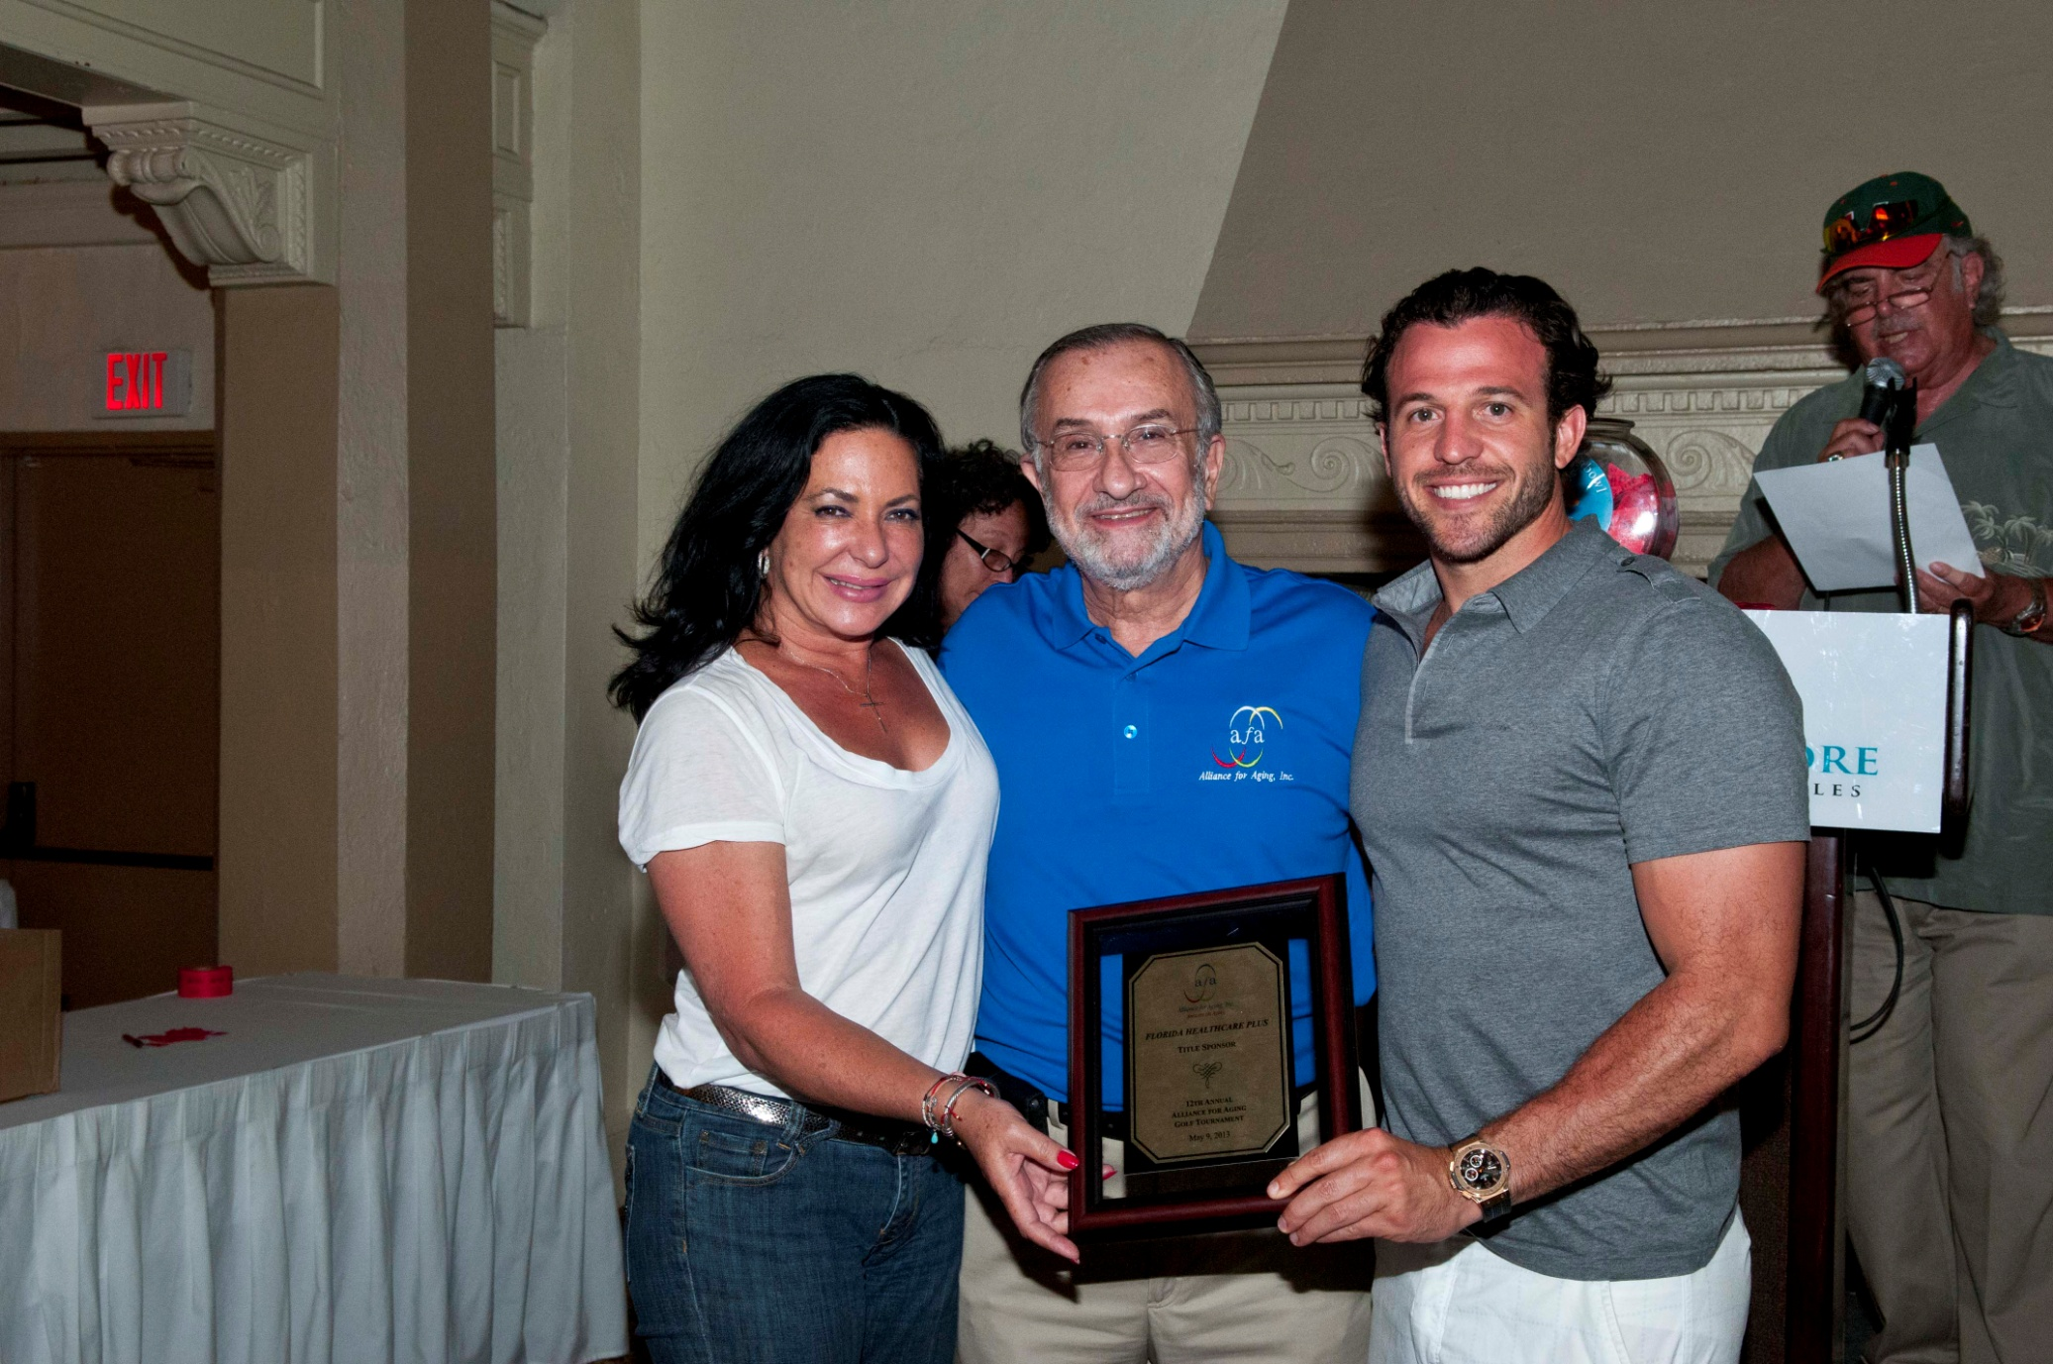

Slide 40






Many thanks to our In-Kind and
Goody Bag Donors
Mandy Llanes/Anheuser-Busch
Costco
Sue & Steve Grimes/Gold Star Printing
Phil Lyons/InSource
Milton Fisher/Janney Montgomery Scott
Jorge Rojas/Pepsico

Slide 41
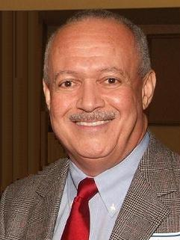
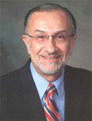
Our Leadership:
Winston H. Lonsdale
Board Chair
Max B. Rothman, JD, LL.M. President and CEO

Slide 42

Many thanks to our Hole Sponsors:
Many thanks to our Hole Sponsors:
Catholic Hospice
Karen Walker/Holland & Knight

Slide 43
Raffle and Auction Donors:
Seaworld
SGI Resorts International
Shake Shack
Shula’s Golf
Stage Door Theatre
Trujillo Chiropractic Center
Vizcaya Museum & Gardens
Walt Disney World
ZooMiami

Slide 44

Many thanks to our
Golf Cart Sponsors
Providence Healthcare Services
Vitas Innovative Hospice Care

Slide 45
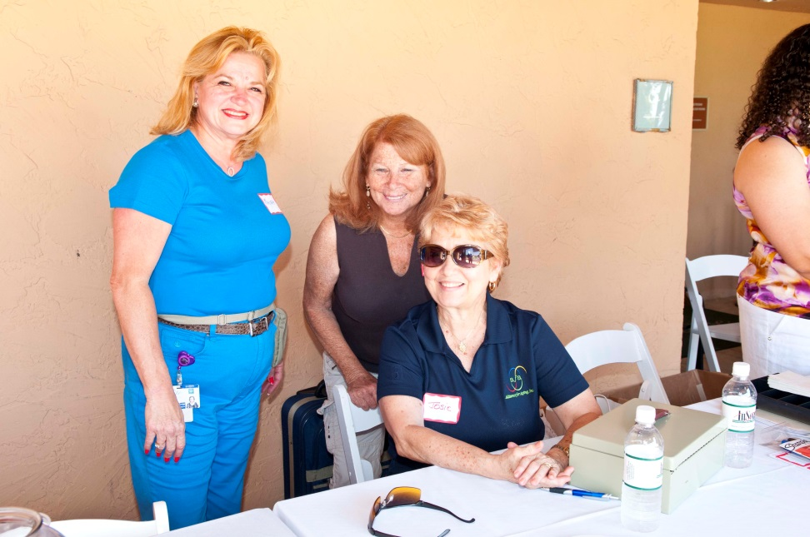
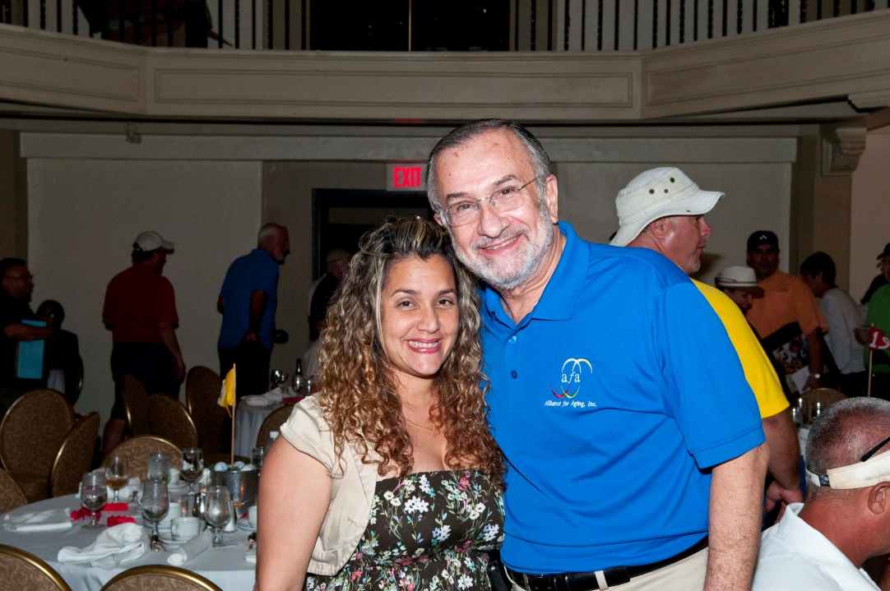

Slide 46
THANK YOU TO THE GOLF TOURNAMENT COMMITTEE
Sandra Colon, William Diaz,
Catalina Febles, Alex Fiuza,
Cyndi Guerra, Lorraine Harris,
Maria Hidalgo, Ted Lyons, Mayra Poldo, Eileen Torres, Ines Vital

Slide 47


Slide 48
Thank you for your support of
The Alliance for Aging Golf Tournament

